Slide 1
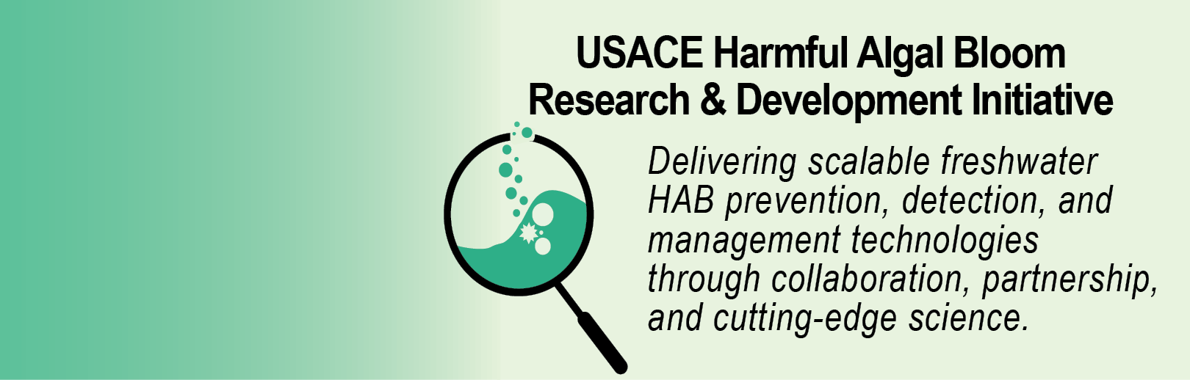


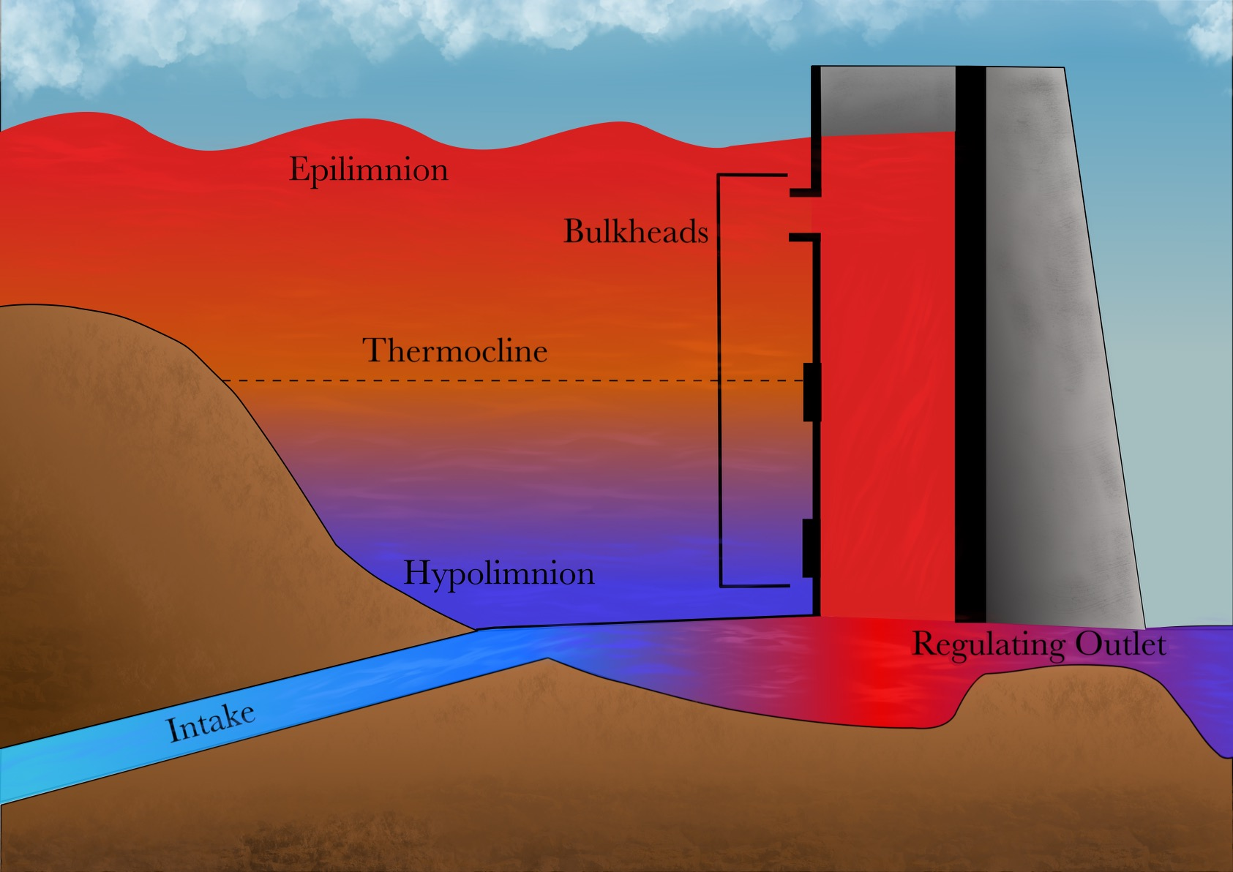
Development of a Predictive HAB Planning Tool using CE-QUAL-W2 Todd Steissberg (Todd.E.Steissberg@erdc.dren.mil, 530-574-5572), Jodi Ryder, Emily Summers, Halie Suk, Isaac Mudge
Problem Statement
Technical Approach Cont’d
Current models inadequately predict HAB timing, frequency, intensity, spatial variability, and impacts. A predictive HAB planning tool will be developed using ERDC’s reservoir water quality model, CE-QUAL-W2.
Task 3. Implement new HAB simulation capabilities into CE-QUAL-W2 and develop post-processing tools.
Task 4. Test new HAB simulation and prediction capabilities.
Task 5: Select demonstration site, gather data, validate CE-QUAL-W2 for HAB growth, transport, and decay.
Task 6: Perform demonstration study, calibrate/validate model results, compute model statistics, debug new algorithms.
Tasks 7 & 8: Technical transfer – publications and webinar
Technical Approach
Deliverables & Schedule
Describe technical approach, highlight:
Task 1. Perform literature review of current HAB physical effects and biological behaviors and analysis of current CE-QUAL-W2 capabilities and limitations. Product: Technical Report
Go/no go point: Determine which methods and species to target for design.
Task 2. Develop a design plan for implementing new simulation algorithms into CE-QUAL-W2 and developing post-processing analysis tools.
Journal paper: “Current Capabilities and Opportunities for Numerical Water Quality Modeling of Harmful Algae Blooms”, in review, Q2/FY24
Software: Upgraded CE-QUAL-W2 model with HAB capabilities, Q4/FY25
Documentation: User’s manual appendix on HAB modeling, Q4/FY25
Guidance: “Using CE-QUAL-W2 to Evaluate Reservoir HAB Management Strategies, Q2/FY26
Presentation: “Advancing Harmful Algal Bloom Management with the CE-QUAL-W2 Water Quality Model”, EPA Water Modeling Forum, Q1/FY26
Tech Report: “Design of HAB Simulation Capabilities for CE-QUAL-W2”, in review, Q2/FY24
Tech Report: “Case Study: Simulating HABs with CE-QUAL-W2”, submitted, Q2/FY26
Tech Report: “CE-QUAL-W2 HAB Simulation Capabilities”, submitted, Q2/FY26
ANSRP Harmful Algal Bloom Congressional Interest In-Progress Review

Slide 2

Development of a Predictive HAB Planning Tool using CE-QUAL-W2 Todd Steissberg (Todd.E.Steissberg@erdc.dren.mil, 530-574-5572), Jodi Ryder, Emily Summers, Halie Suk, Isaac Mudge
CE-QUAL-W2 Overview
CE‐QUAL‐W2 is a two‐dimensional (2D), longitudinal/vertical, hydrodynamics and water quality model for reservoirs that enables characterization of vertical and longitudinal changes in reservoirs.
The model assumes reservoirs are well mixed laterally, with no variation from one channel side to the other in a layer (vertical) and segment (longitudinal).
CE-QUAL-W2 has been applied to rivers, lakes, reservoirs, and estuaries.
ANSRP Harmful Algal Bloom Congressional Interest In-Progress Review

Slide 3
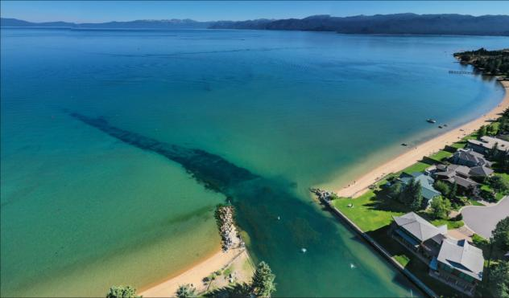
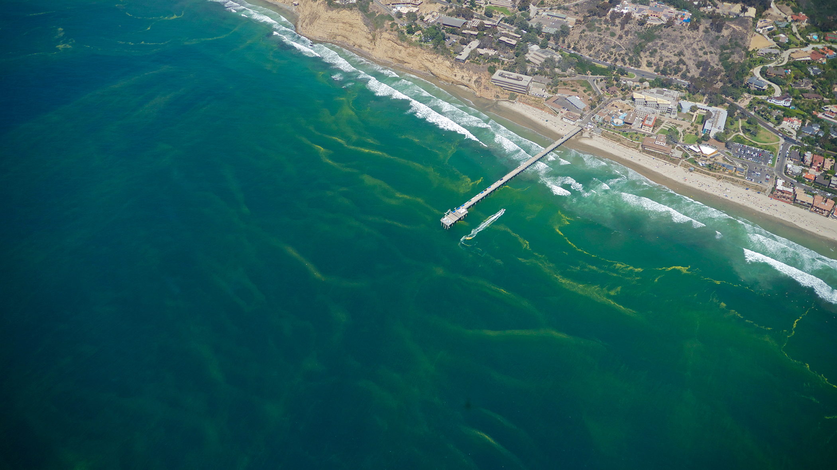
Development of a Predictive HAB Planning Tool using CE-QUAL-W2 Todd Steissberg (Todd.E.Steissberg@erdc.dren.mil, 530-574-5572), Jodi Ryder, Emily Summers, Halie Suk, Isaac Mudge
CE-QUAL-W2 Water Quality Capabilities
Longitudinal-vertical hydrodynamics and water quality in stratified and non-stratified systems
Multiple algae, epiphyton/periphyton, zooplankton, and macrophytes
Nutrients-dissolved oxygen-organic matter interactions
Vertical migration algorithms
Selective withdrawal from stratified reservoir outlets
Can selectively release from epilimnion or hypolimnion
Hypolimnetic aeration
Hydraulic structure algorithms
Fish habitat volume
Sediment diagenesis
Carbonaceous Biochemical Oxygen Demand (CBOD)
Generic water quality groups
Dynamic shading algorithm based on topography and vegetation
ANSRP Harmful Algal Bloom Congressional Interest In-Progress Review

Slide 4


Development of a Predictive HAB Planning Tool using CE-QUAL-W2 Todd Steissberg (Todd.E.Steissberg@erdc.dren.mil, 530-574-5572), Jodi Ryder, Emily Summers, Halie Suk, Isaac Mudge
Challenges and Solutions
Predicting HABs is very challenging. Reservoirs have characteristics that can vary significantly:
Algal species
Diurnal vertical migration of some species of cyanobacteria
Mixing dynamics (temperature and wind forcing)
Geometry
Volume, surface area, depth, and fetch
Morphometry (length, width, shape, shoreline)
Harmful algal blooms can exhibit rapid changes and non-linear dynamics that are difficult to capture in model simulations.
To address these issues:
Extensive literature review
Feedback gathered from HAB experts
Detroit Reservoir, Oregon
Detroit Lake HAB
ANSRP Harmful Algal Bloom Congressional Interest In-Progress Review

Slide 5
Development of a Predictive HAB Planning Tool using CE-QUAL-W2 Todd Steissberg (Todd.E.Steissberg@erdc.dren.mil, 530-574-5572), Jodi Ryder, Emily Summers, Halie Suk, Isaac Mudge
HAB Expert Panel Recommendations
21 needs/opportunities were identified for CE-QUAL-W2 to improve its HAB simulation and analysis capabilities.
Five of these were prioritized for implementation and/or evaluation.
Vertical migration (CE-1) is an existing capability. We performed experiments to understand its strengths and limitations and parametrize the minimum vertical grid resolution.
Nitrogen fixation (CE-2), minimum algae concentration (CE-4), hypoxic conditions (CE-3), and treatment regimens (CE-5) were selected for design and implementation.
ANSRP Harmful Algal Bloom Congressional Interest In-Progress Review

Slide 6
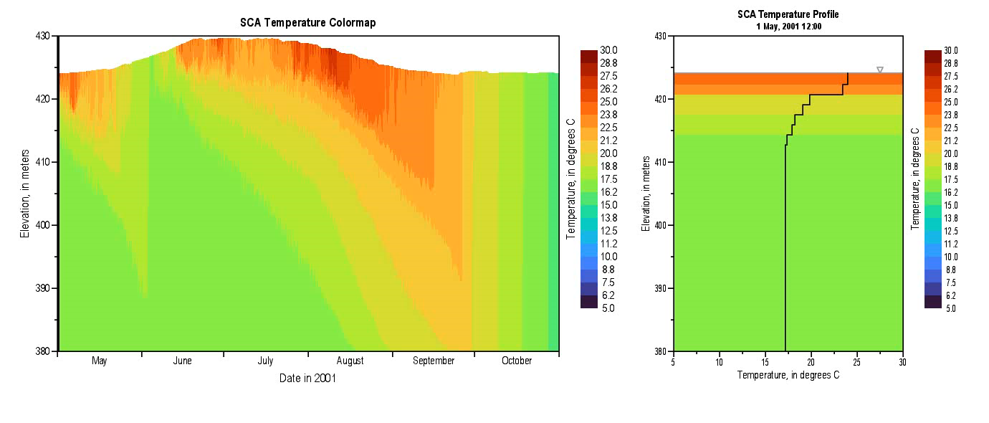
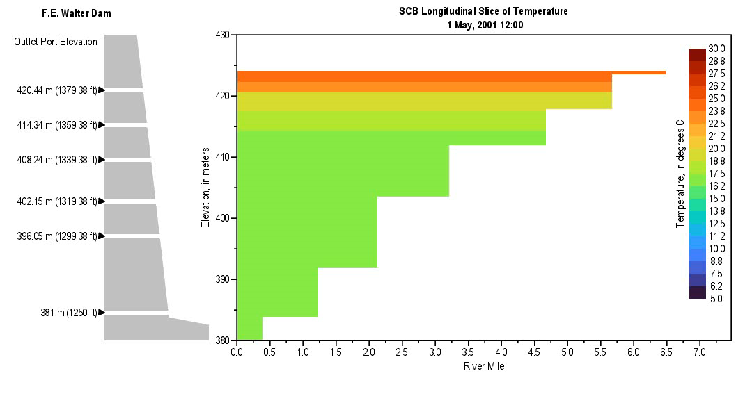
Development of a Predictive HAB Planning Tool using CE-QUAL-W2 Todd Steissberg (Todd.E.Steissberg@erdc.dren.mil, 530-574-5572), Jodi Ryder, Emily Summers, Halie Suk, Isaac Mudge
CE-QUAL-W2 Enhancements
CE-2: Nitrogen fixation supports simulation of cyanobacteria dominance in low-nitrogen conditions. Cyanobacteria may outcompete native algae since they can fix nitrogen.
CE-3: Hypoxia-associated mortality reflects algal population and chemistry dynamics under low oxygen stress.
CE-4: Minimum algae concentration enforcement to support post-crash recovery.
CE-5: Mechanical removal (treatments, harvesting) to simulate interventions such as skimming or pumping.
ANSRP Harmful Algal Bloom Congressional Interest In-Progress Review

Slide 7
Development of a Predictive HAB Planning Tool using CE-QUAL-W2 Todd Steissberg (Todd.E.Steissberg@erdc.dren.mil, 530-574-5572), Jodi Ryder, Emily Summers, Halie Suk, Isaac Mudge
HAB Processes and Management
ANSRP Harmful Algal Bloom Congressional Interest In-Progress Review

Slide 8
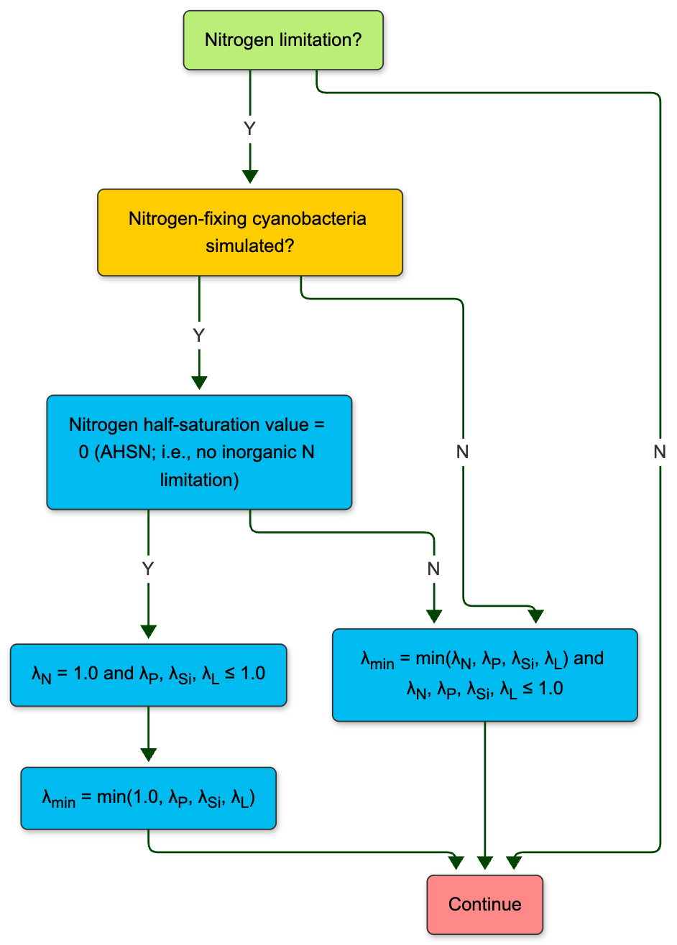
Development of a Predictive HAB Planning Tool using CE-QUAL-W2 Todd Steissberg (Todd.E.Steissberg@erdc.dren.mil, 530-574-5572), Jodi Ryder, Emily Summers, Halie Suk, Isaac Mudge
Nitrogen Fixation (CE-2)
Purpose: To simulate atmospheric nitrogen uptake by diazotrophic algae under nitrogen-limited conditions.
Implementation:
Optional activation per algal group, enabled through user input.
Adds a supplementary nitrogen source term when DIN concentrations fall below a user-defined threshold.
Internal logic uses a Monod-like function to modulate fixation rate based on DIN availability.
Ensures conservation of mass and allows continuous algal growth in nitrogen-limited but phosphorus-replete environments.
ANSRP Harmful Algal Bloom Congressional Interest In-Progress Review

Slide 9
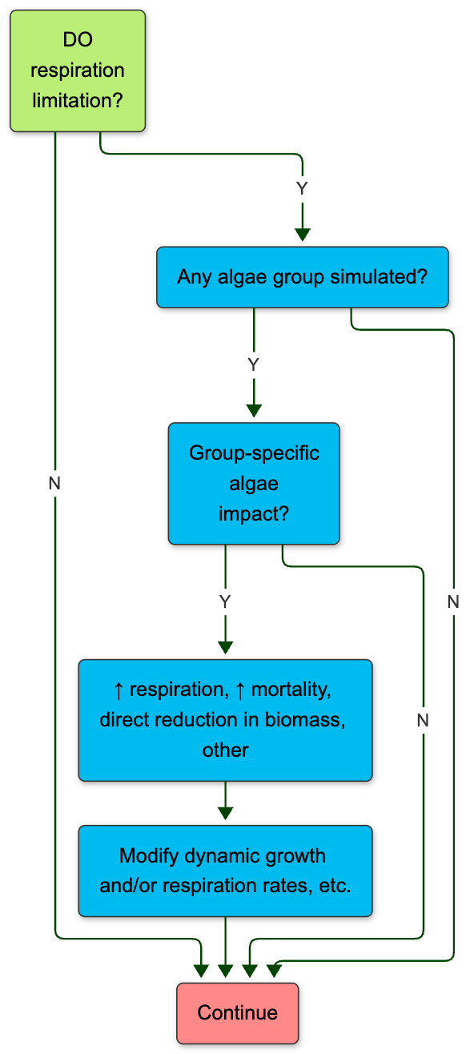
Development of a Predictive HAB Planning Tool using CE-QUAL-W2 Todd Steissberg (Todd.E.Steissberg@erdc.dren.mil, 530-574-5572), Jodi Ryder, Emily Summers, Halie Suk, Isaac Mudge
Hypoxic Conditions (CE-3)
Purpose: To increase algal mortality in response to low dissolved oxygen (DO), reflecting physiological stress and bloom collapse under hypoxic conditions.
Implementation:
Logic added to algal growth and mortality routines to apply increased death rate when DO falls below a user-defined threshold.
Supports multiple response forms: step function, linear scaling, or Monod-style inhibition.
Applies uniformly to all algae in affected segments unless otherwise configured.
ANSRP Harmful Algal Bloom Congressional Interest In-Progress Review

Slide 10
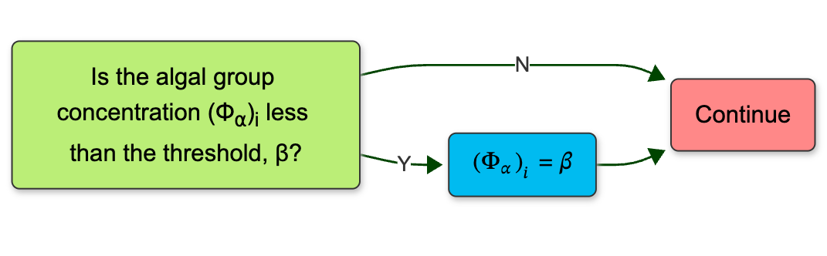
Development of a Predictive HAB Planning Tool using CE-QUAL-W2 Todd Steissberg (Todd.E.Steissberg@erdc.dren.mil, 530-574-5572), Jodi Ryder, Emily Summers, Halie Suk, Isaac Mudge
Minimum Algae Concentration (CE-4)
Purpose: To prevent complete depletion of algae due to high mortality events, enabling post-bloom recovery in the absence of boundary-driven reintroduction.
Implementation:
A user-defined floor value for algal biomass is enforced after each time step.
The logic is embedded within the wqconstituents.f90 file and applied across all layers and segments where algal concentrations fall below the minimum.
An optional input parameter allows global or group-specific specification of the threshold.
The minimum value acts as a lower bound; once concentrations fall below it due to mortality or other sinks, they are reset to the threshold for subsequent time steps.
ANSRP Harmful Algal Bloom Congressional Interest In-Progress Review

Slide 11
Development of a Predictive HAB Planning Tool using CE-QUAL-W2 Todd Steissberg (Todd.E.Steissberg@erdc.dren.mil, 530-574-5572), Jodi Ryder, Emily Summers, Halie Suk, Isaac Mudge
Algal Treatment (Mechanical Removal/Harvesting)
Purpose: To simulate segment-specific algal biomass removal, reflecting surface skimming, pumping, or other mechanical control actions.
Implementation:
New input file defines the active segments, interpolation method, and time-series file path.
A time-varying file provides fractional reductions by segment and simulation day.
Users specify a harvesting depth
Removal was implemented as an instantaneous fractional reduction in the algal state variables during the time step corresponding to the input.
ANSRP Harmful Algal Bloom Congressional Interest In-Progress Review

Slide 12
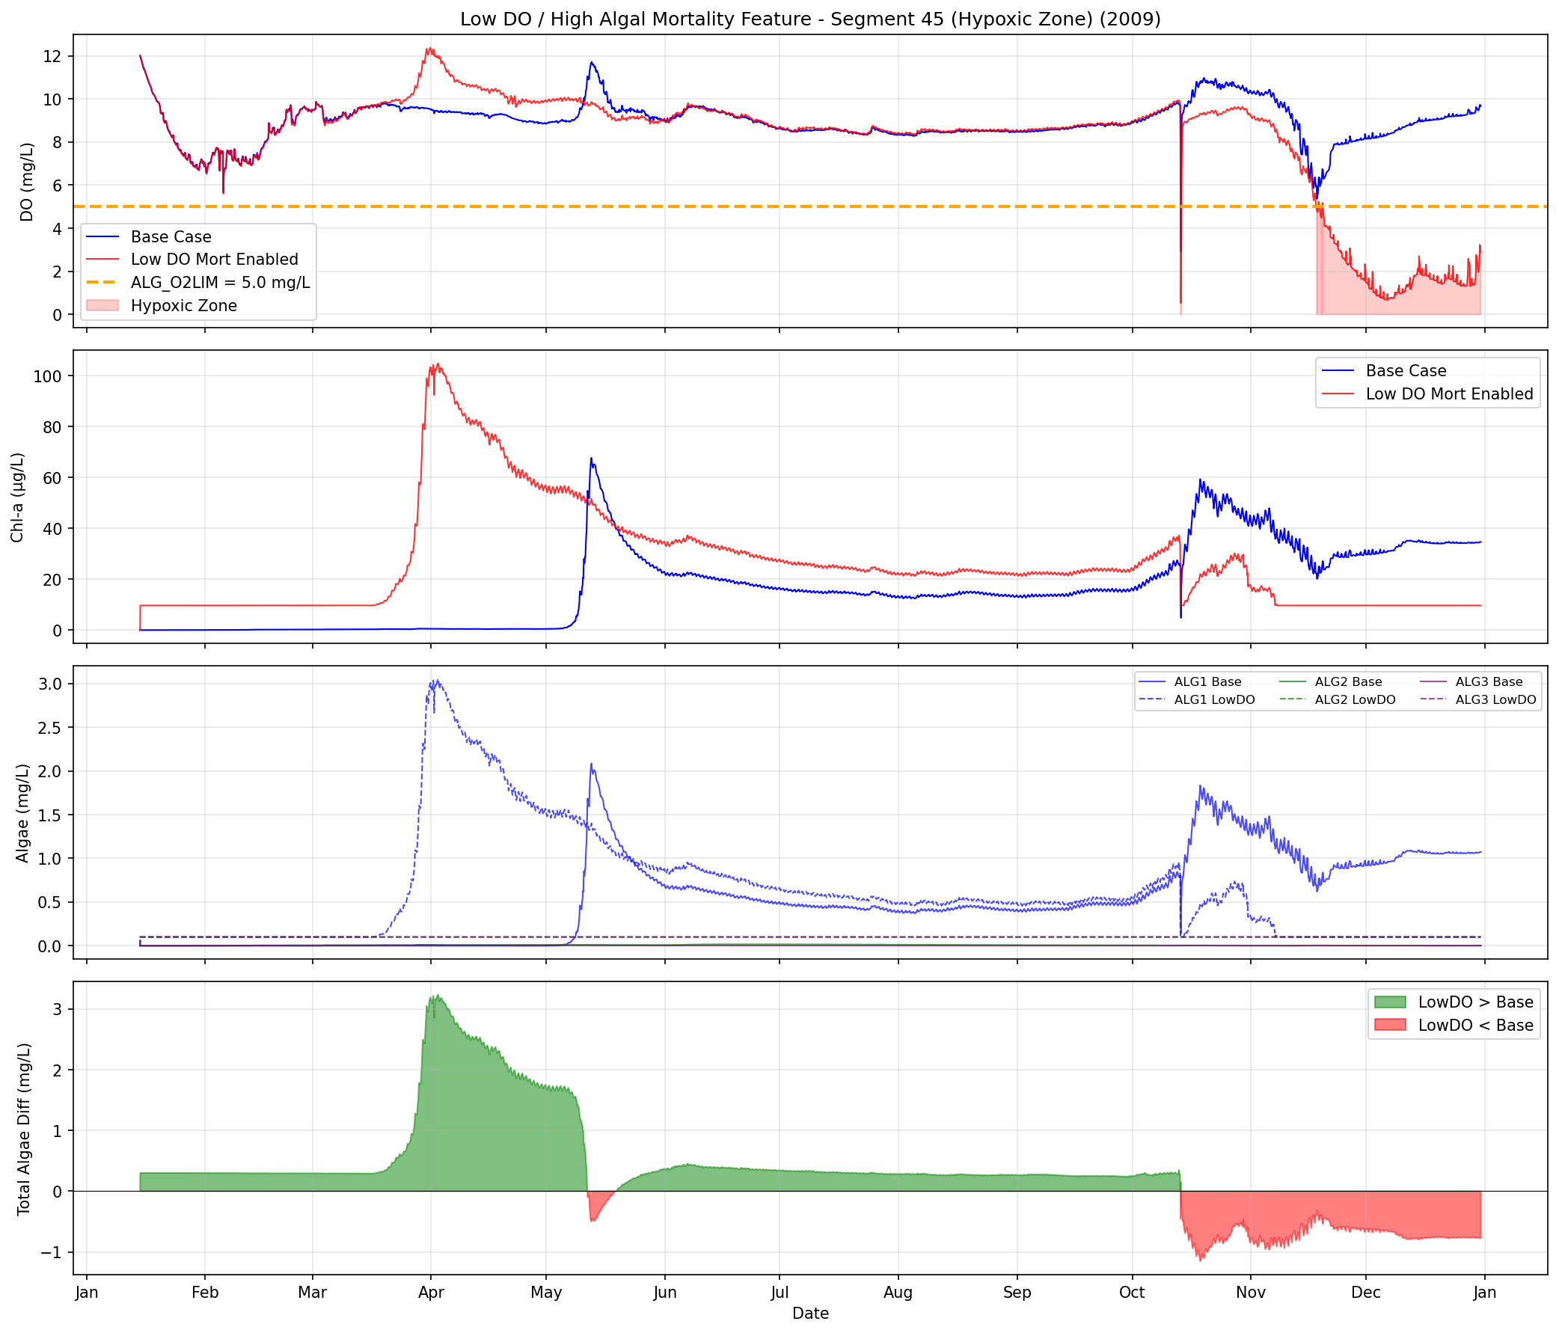
Development of a Predictive HAB Planning Tool using CE-QUAL-W2 Todd Steissberg (Todd.E.Steissberg@erdc.dren.mil, 530-574-5572), Jodi Ryder, Emily Summers, Halie Suk, Isaac Mudge
Results: Hypoxic Conditions and Minimum Algae Concentration
Hypoxic DO Threshold: 5 mg/L
Minimum Algae Concentration: 5 µg/L
ANSRP Harmful Algal Bloom Congressional Interest In-Progress Review

Slide 13
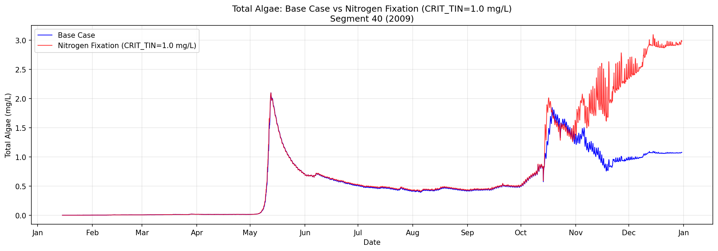
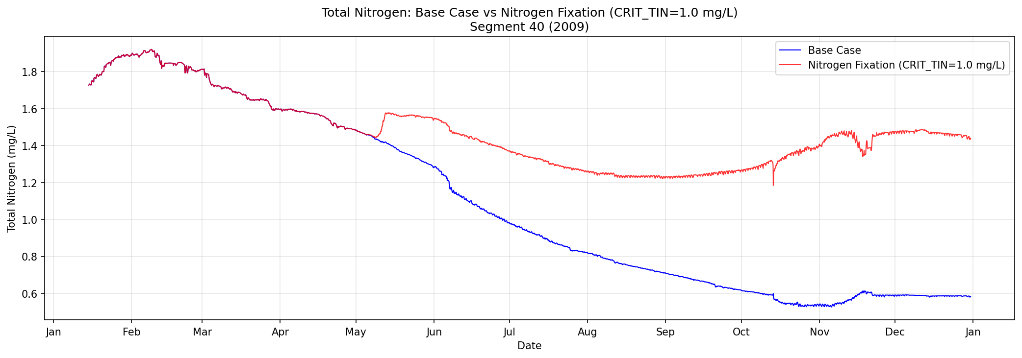
Development of a Predictive HAB Planning Tool using CE-QUAL-W2 Todd Steissberg (Todd.E.Steissberg@erdc.dren.mil, 530-574-5572), Jodi Ryder, Emily Summers, Halie Suk, Isaac Mudge
Results: Nitrogen Fixation
Critical Total Inorganic Nitrogen (TIN) Threshold: 1.0 mg/L
ANSRP Harmful Algal Bloom Congressional Interest In-Progress Review

Slide 14
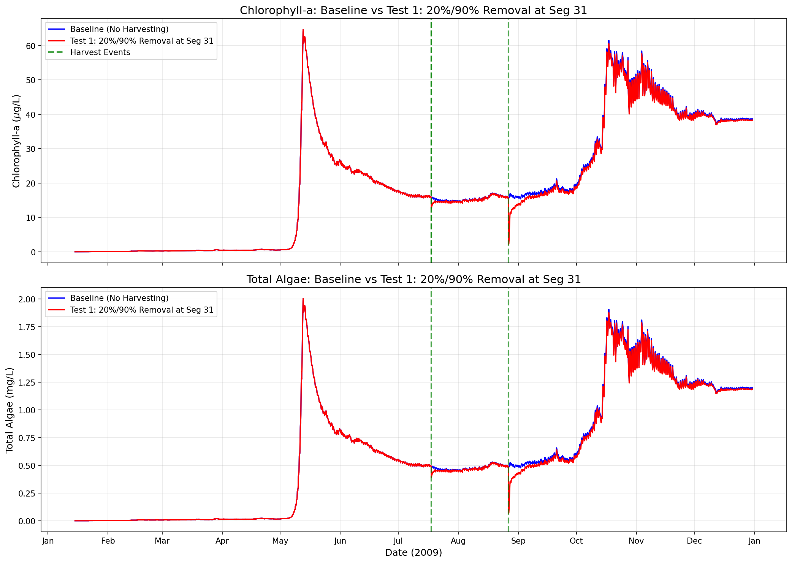
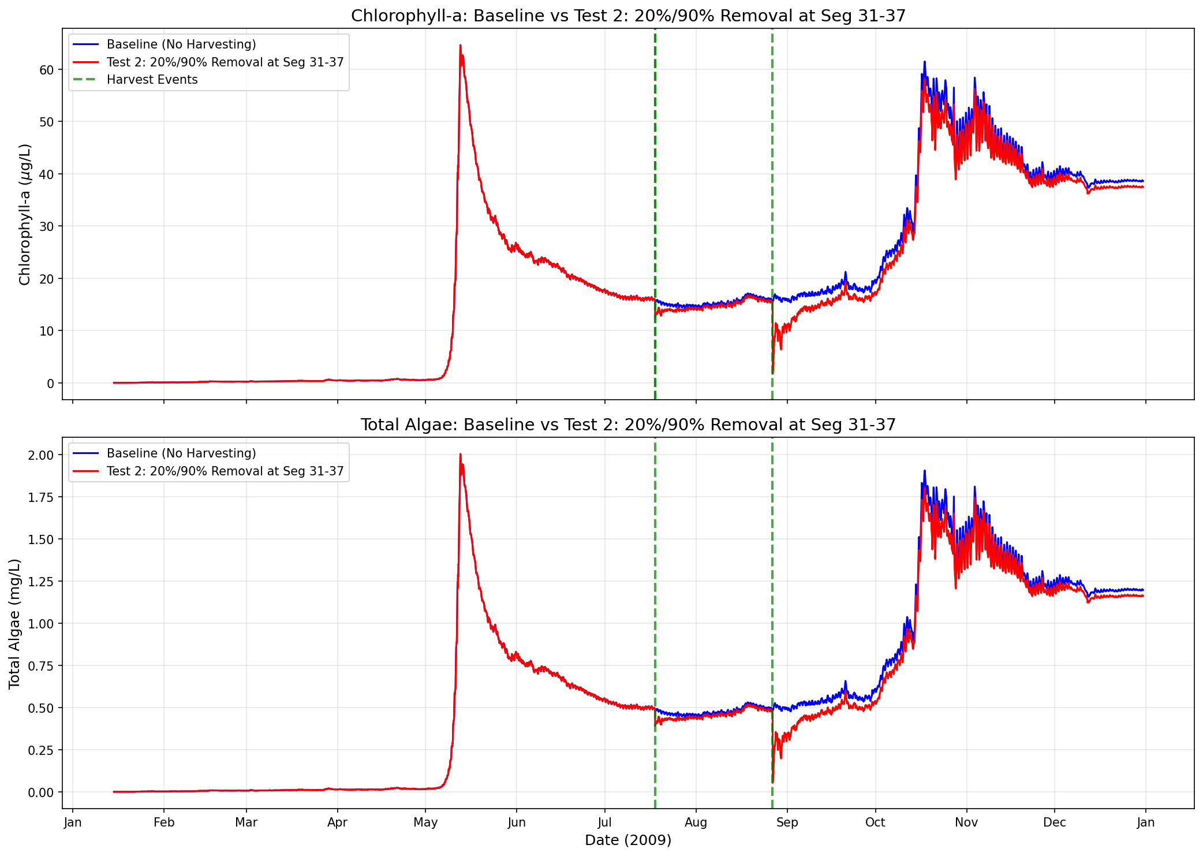
Development of a Predictive HAB Planning Tool using CE-QUAL-W2 Todd Steissberg (Todd.E.Steissberg@erdc.dren.mil, 530-574-5572), Jodi Ryder, Emily Summers, Halie Suk, Isaac Mudge
Results: Algal Harvesting
ANSRP Harmful Algal Bloom Congressional Interest In-Progress Review

Slide 15
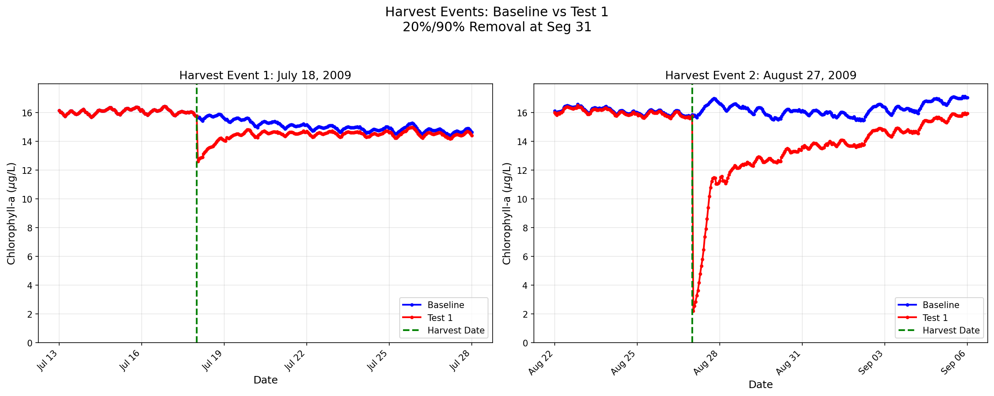
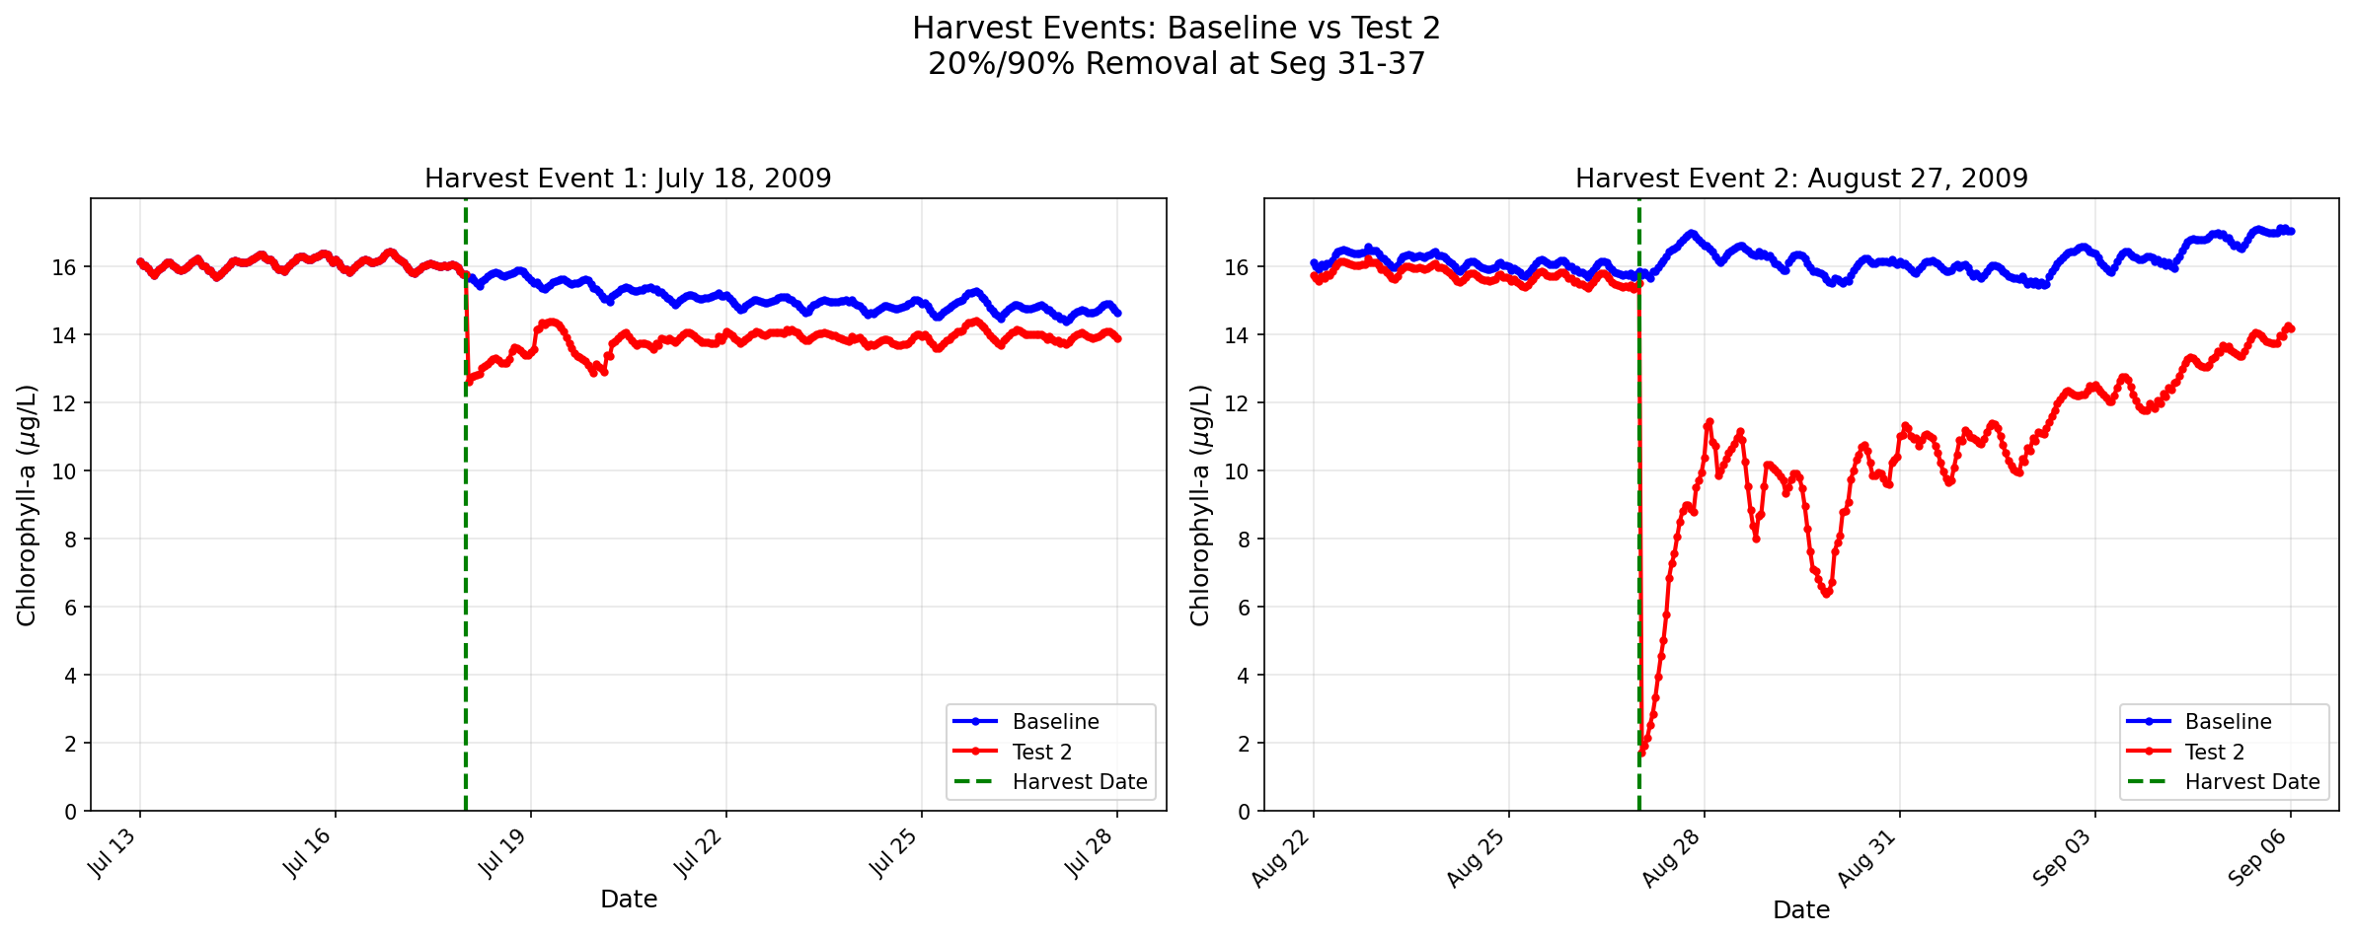
Development of a Predictive HAB Planning Tool using CE-QUAL-W2 Todd Steissberg (Todd.E.Steissberg@erdc.dren.mil, 530-574-5572), Jodi Ryder, Emily Summers, Halie Suk, Isaac Mudge
Results: Algal Harvesting (Detailed View)
ANSRP Harmful Algal Bloom Congressional Interest In-Progress Review

Slide 16
Development of a Predictive HAB Planning Tool using CE-QUAL-W2 Todd Steissberg (Todd.E.Steissberg@erdc.dren.mil, 530-574-5572), Jodi Ryder, Emily Summers, Halie Suk, Isaac Mudge
Simulating Operational Strategies for HAB Management
Hypolimnetic Withdrawal
Surface Flushing
Pulsed Inflows
Quantify P & N mass exported via deep (hypolimnetic) releases
Track thermocline response to withdrawal rates
Determine minimum flow to reduce residence time below bloom threshold
Simulate bloom recovery time after flushing ends
Model plunge depth based on inflow temperature
Evaluate stratification disruption vs. pulse magnitude
Artificial Mixing
Hypolimnetic Aeration
Water Level, Temperature Control
Structures, Harvesting
Test mixing intensity (K_{z}) to achieve mixing
Compare algal biomass under continuous vs. intermittent mixing
Simulate O₂-dependent sediment P release reduction
Multi-year runs to assess cumulative internal load decrease
Evaluate residence time changes with pool elevation
Specify harvesting rates & locations for biomass removal
Scenario-based evaluation of individual of various control strategies with CE-QUAL-W2 will improve identification of site-specific bloom drivers and development of HAB management plans.
ANSRP Harmful Algal Bloom Congressional Interest In-Progress Review

Slide 17
Development of a Predictive HAB Planning Tool using CE-QUAL-W2 Todd Steissberg (Todd.E.Steissberg@erdc.dren.mil, 530-574-5572), Jodi Ryder, Emily Summers, Halie Suk, Isaac Mudge
Challenges
Significant loss of team members in FY24 delayed work and expenditures
HABs in the Detroit Lake case study did not provide extremes of high algal and low DO concentrations needed to test key capabilities
Algal harvesting introduces a small mass balance error. Although expected to be small, this needs to be tracked.
Version and outdated compiler issues.
Solutions
Added new team members in FY25.
Merged HAB algorithms with CE-QUAL-W2 V4.5 code
Developed a mass balance tracking feature, leveraging CE-QUAL-W2’s existing capabilities
Updated code to compile with latest compilers and switched to the gfortran compiler. Also developed MacOS and Linux versions and a version for HPC (funded by HH&C SET).
CE-QUAL-W2 will be updated to use the latest Intel Fortran compiler (HH&C SET funds)
ANSRP Harmful Algal Bloom Congressional Interest In-Progress Review

Slide 18
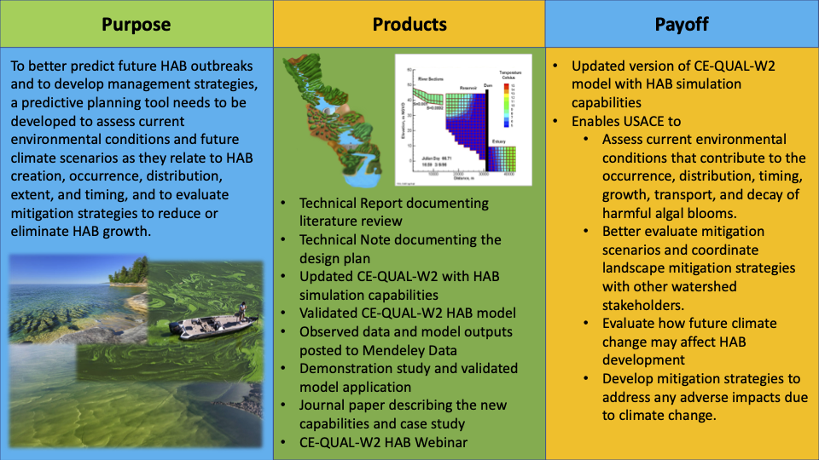
Development of a Predictive HAB Planning Tool using CE-QUAL-W2 Todd Steissberg (Todd.E.Steissberg@erdc.dren.mil, 530-574-5572), Jodi Ryder, Emily Summers, Halie Suk, Isaac Mudge
Forecasting Project Hurdles
Physical and biological processes have been found to vary considerably by species, reservoir geometry, etc. We focused on one species at one site.
Value to USACE Operations
CE-QUAL HAB models will enable USACE to assess environmental conditions that contribute to the growth, transport, and decay of HABs. They will show the spatial response and variability of HABs, evolving over short time scales, informing mitigation planning and response.
Deliverables by Year
Literature review, FY23
Journal Paper: Literature review, FY24
Technical Report on HAB simulation capability design, FY25
Completed model and case study, FY25
Three Technical Reports, FY25-26
ANSRP Harmful Algal Bloom Congressional Interest In-Progress Review

